Slide 1
EXAM TWO REVIEW
Database Concepts
Spring 2021
Week 13

Slide 2
Scope
Chapters 4-7
Test-taking: via Canvas (open book)
Date/Location: Apr. 15; take-home
Available: Apr. 15 from 12:01am – 1:00pm
Time: (75 minutes)
Format
Open Book, online (you are allowed to use your laptop to check electronic copies)

Slide 3
ENTITY RELATIONSHIP MODELING

Slide 4


Existence Dependence
Existence dependence
Entity exists in the database only when it is associated with another related entity occurrence
Existence independence
Entity exists apart from all of its related entities
Referred to as a strong entity or regular entity
Notes:
An entity is said to be existence-dependent if it can exist in the database only when it is associated with another related entity occurrence. An entity is existence-dependent if it has a mandatory foreign key—that is, a foreign key attribute that cannot be null.
If an entity can exist apart from all of its related entities, then it is existence-independent, and it is referred to as a strong entity or regular entity.
A mandatory FK condition does not necessarily produce a strong (identifying) relationship. If the FK is not part of the PK, the relationship is weak, regardless of the role it plays in existence-dependency.

Slide 5
Relationship Strength
Based on how the primary key of a related entity is defined
Weak (non-identifying) relationships
Primary key of the related entity does not contain a primary key component of the parent entity
Strong (identifying) relationships
PK of a child entity contains at least part of its primary key from a parent entity.
Depicted as a solid line in a Crow’s Foot
Notes:
The concept of relationship strength is based on how the primary key of a related entity is defined. To implement a relationship, the primary key of one entity (the parent entity, normally on the “one” side of the one-to-many relationship) appears as a foreign key in the related entity (the child entity, mostly the entity on the “many” side of the one-to-many relationship). Sometimes the foreign key also is a primary key component of that entity.
if the FK of an entity is not part of its PK, the relationship between the two entities is weak.
f the FK of an entity is part of its PK, the relationship between the two entities is strong.

Slide 6
Weak Entity
Conditions
The entity must be existence-dependent on its parent entity.
The entity must inherit at least part of its primary key from its parent entity.
Notes:
A weak entity is always existence-dependent on its related entity, because a PK cannot contain nulls. Therefore, a weak entity is one that participates in a strong (identifying) relationship.

Slide 7


Relationship Participation
Optional participation=Optinality
One entity occurrence does not require a corresponding entity occurrence in a particular relationship
Mandatory participation
One entity occurrence requires a corresponding entity occurrence in a particular relationship
Notes:
If no optionality symbol is depicted with the entity, the entity is assumed to exist in a mandatory relationship with the related entity.

Slide 8
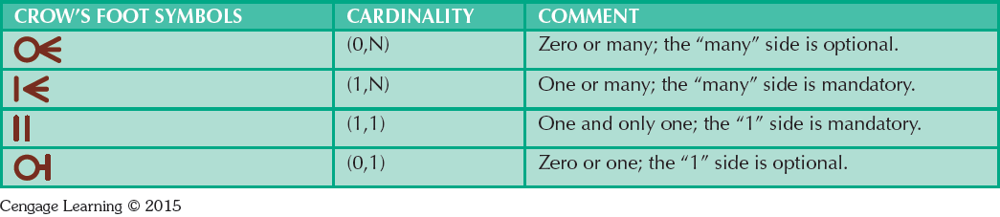
Table 4.3 - Crow’s Foot Symbols

Slide 9
Relationship Degree
Indicates the number of entities or participants associated with a relationship
Unary relationship: Association is maintained within a single entity
Recursive relationship: A recursive relationship exists when an entity is related to itself. For example, a COURSE may be a prerequisite to a COURSE. (p. 133)
Binary relationship: Two entities are associated
Ternary relationship: Three entities are associated
Notes:
A relationship degree indicates the number of entities or participants associated with a relationship. A unary relationship exists when an association is maintained within a single entity. A binary relationship exists when two entities are associated. A ternary relationship exists when three entities are associated.

Slide 10
Associative (Composite) Entities
Also known as bridge entities
Used to represent an M:N relationship between two or more entities
Is in a 1:M relationship with the parent entities
Composed of the primary key attributes of each parent entity
May also contain additional attributes that play no role in connective process

Slide 11
ADVANCED DATA MODELING

Slide 12
Entity Supertypes and Subtypes
Entity supertype
Generic entity type related to one or more entity subtypes
Contains common characteristics
Minimize the likelihood of redundant relationships
Minimize the number of nulls
Entity subtype
Contains unique characteristics of each entity subtype

Slide 13
Specialization Hierarchy
Depicts arrangement of higher-level entity supertypes
and lower-level entity subtypes
Relationships are described in terms of “is-a” relationships
Subtype exists within the context of a supertype
Every subtype has one supertype to which it is directly related
Supertype can have many subtypes
subtypes.

Slide 14
Specialization Hierarchy
Specialization
Top-down process of identifying lower-level, more specific subtypes from a higher-level entity supertype.
Generalization
Bottom-up process of identifying a higher-level, more generic entity supertype from lower-level entity subtypes.

Slide 15
Specialization Hierarchy
Provides the means to:
Support attribute inheritance
Define a special supertype attribute known as the subtype discriminator
Define disjoint/overlapping constraints and complete/partial constraints

Slide 16
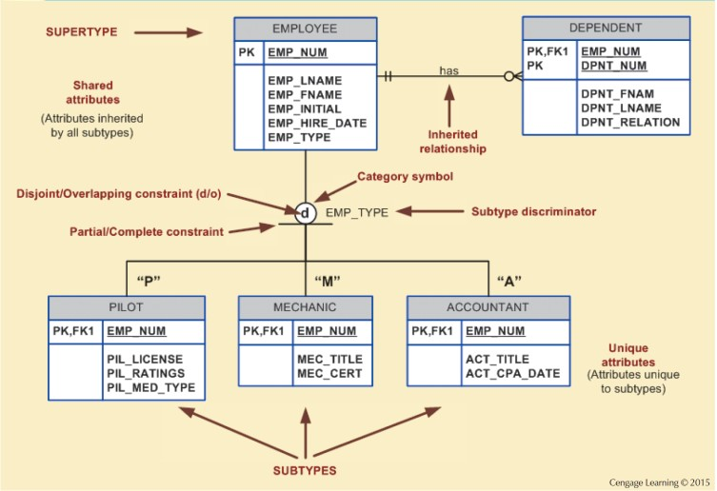
Figure 5.2 - Specialization Hierarchy

Slide 17
Inheritance
Enables an entity subtype to inherit attributes and relationships of the supertype
All entity subtypes inherit their primary key attribute from their supertype
At the implementation level, supertype and its subtype(s) maintain a 1:1 relationship
Entity subtypes inherit all relationships in which supertype entity participates
Lower-level subtypes inherit all attributes and relationships from its upper-level supertypes

Slide 18
Subtype Discriminator
Attribute in the supertype entity that determines to which entity subtype the supertype occurrence is related
Default comparison condition is the equality comparison

Slide 19
Disjoint and Overlapping Constraints
Disjoint subtypes: Each entity instance of the supertype appear in only one of the subtypes
Known as nonoverlapping subtypes
Implementation is based on the value of the subtype discriminator attribute in the supertype (EMP_TYPE)
Overlapping subtypes: Each entity instance of the supertype may appear in more than one subtype
Implementation requires the use of one discriminator attribute for each subtype (EMP_IS_P, EMP_IS_M, EMP_IS_A…)
Notes:
Disjoint/non-overlapping: subtype entity set contains a unique subset of the supertype entity set.
Overlapping: subtype entity set contain non-unique subsets of the supertype entity set.

Slide 20
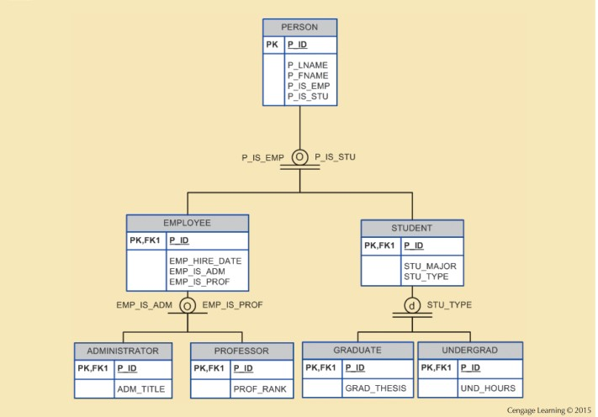
Figure 5.4 - Specialization Hierarchy with Overlapping Subtypes

Slide 21
Completeness Constraint
Specifies whether each supertype occurrence must also be a member of at least one subtype
Types
Partial completeness: Not every supertype occurrence is a member of a subtype
Total completeness: Every supertype occurrence must be a member of at least one subtype

Slide 22
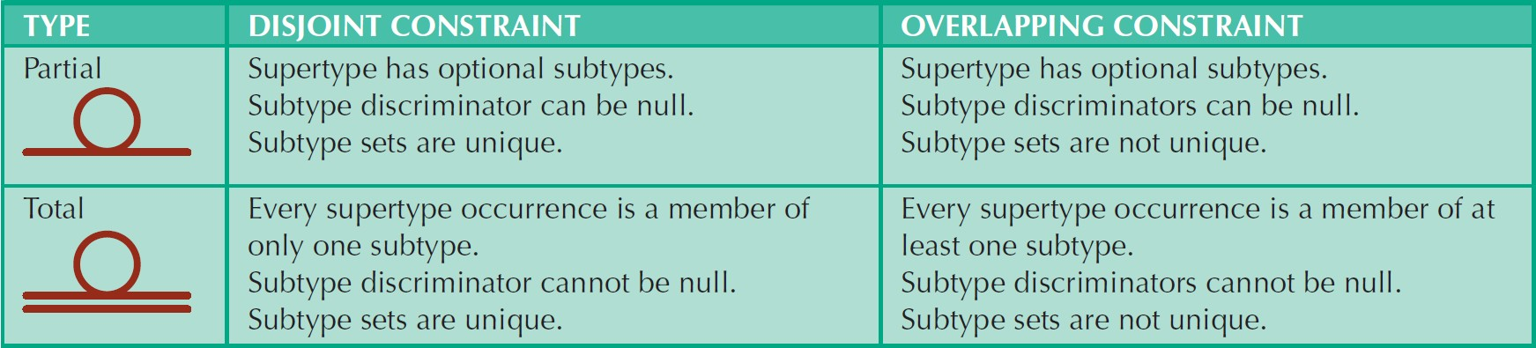
Table 5.2 - Specialization Hierarchy Constraint Scenarios

Slide 23
Entity Cluster
Temporary (virtual) entity used to represent multiple entities and relationships in ERD
Combining multiple interrelated entities into a single abstract entity object
Represent multiple entities and relationships to simplify the ERD and enhance its readability

Slide 24
Primary Keys
Single attribute or a combination of attributes, which uniquely identifies each entity instance or row
Guarantees entity integrity
Works with foreign keys to implement relationships
cf.) Composite key: Key that is composed of more than one attribute

Slide 25
Use of Composite Primary Keys
Composite primary keys are useful in two cases:
As identifiers of composite entities, in which each primary key combination is allowed only once in the M:N relationship
As identifiers of weak entities, in which the weak entity has a strong (identifying) relationship with the parent entity (See p. 125).

Slide 26
Natural Keys or Natural Identifier
Real-world identifier used to uniquely identify real-world objects
Familiar to end users and forms part of their day-to-day business vocabulary
Also known as natural identifier
Used as the primary key of the entity being modeled

Slide 27
Surrogate Keys
A primary key created by the database designer to simplify the identification of entity instances
There is no natural key
Selected candidate key has embedded semantic contents or is too long

Slide 28
NORMALIZATION OF DATABASE TABLES

Slide 29
Normalization
Evaluating and correcting table structures to minimize
data redundancies
Reduces data anomalies
Normal forms
First normal form (1NF)
Second normal form (2NF)
Third normal form (3NF)

Slide 30
Normalization
Structural point of view of normal forms
Higher normal forms are better than lower normal forms
Properly designed 3NF structures meet the requirement of fourth normal form (4NF)
Denormalization: Produces a lower normal form
Results in increased performance and greater data redundancy
Notes:
From a structural point of view, 2NF is better than 1NF, and 3NF is better than 2NF. For most purposes in business database design, 3NF is as high as you need to go in the normalization process.

Slide 31
Normalization Process
Objective is to ensure that each table conforms to the concept of well-formed relations
Each table represents a single subject
No data item will be unnecessarily stored in more than one table
All nonprime attributes in a table are dependent on the primary key
Each table is void of insertion, update, and deletion anomalies
Notes:
Non-prime attributes: Attribute set does not belong to any candidate key.
Candidate key: Same characteristics as primary key but not chosen to be the primary key.

Slide 32
Normalization Process
Ensures that all tables are in at least 3NF
Higher forms are not likely to be encountered in business environment
Works one relation at a time
Starts by:
Identifying the dependencies of a relation (table)
Progressively breaking the relation into new set of relations

Slide 33
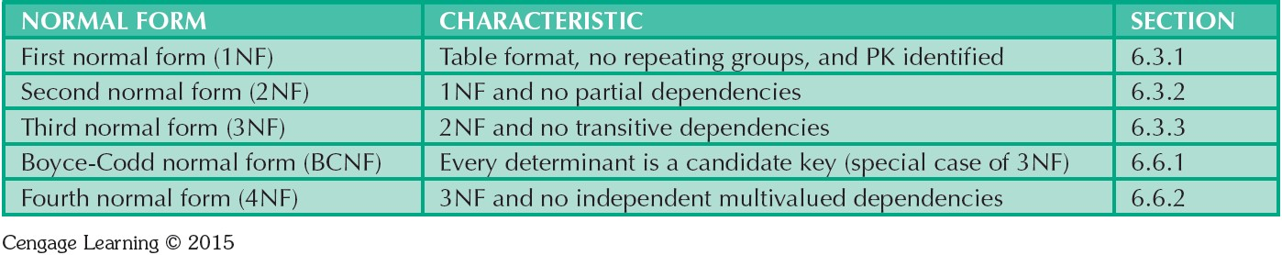
Table 6.2 - Normal Forms

Slide 34
Functional Dependence Concepts
Concept | Definition
Functional dependence | If each value of A determines one and only one value of B, The attribute B is functionally dependent on the attribute A.
Fully functional dependence (composite key) | If attribute B is functionally dependent on a composite key A but not on any Subset of that composite key, the attribute B is fully functionally dependent on A.
Notes:
Example: PROJ_NUM --> PROJ_NAME
(read as PROJ_NUM functionally determines PROJ_NAME)
In this case, the attribute PROJ_NUM is known as the determinant attribute, and the attribute PROJ_NAME is known as the dependent attribute.
An X(composite key) --> Y is a full functional dependency if removal of any attribute A_{i} from X means that the dependency does not hold any more.

Slide 35
Types of Functional Dependencies
Partial dependency: A dependency based on only a part of a composite primary key
Exist when there is a functional dependence in which the determinant is only part of the primary key
If (A, B) → (C, D) also B → C, and (A, B) is the primary key, then the functional dependence B → C is a partial dependency
Transitive dependency: A dependency of one nonprime attribute on another nonprime attribute
Exist when a functional dependence exists among nonprime attributes
X (primary key) → Y (nonprime), Y → Z (nonprime), the dependency Y → Z is a transitive dependency
Notes:
B → C is a partial dependency because only part of the primary key (B) is needed to determine the value of C.

Slide 36
Conversion to First Normal Form (1NF)
Steps
Eliminate the repeating groups
Identify the primary key
Identify all dependencies
Repeating group: Group of multiple entries of same type can exist for any single key attribute occurrence
Existence proves the presence of data redundancies

Slide 37
Conversion to First Normal Form
1NF describes tabular format in which:
All key attributes are defined
There are no repeating groups in the table
All attributes are dependent on the primary key
All relational tables satisfy 1NF requirements

Slide 38
Conversion to Second Normal Form
Steps
Make new tables to eliminate partial dependencies
Reassign corresponding dependent attributes
Table is in 2NF when it:
Is in 1NF
and
Includes no partial dependencies (that is, if the 1NF has a single- attribute primary key, then the table is automatically in 2NF)
Notes:
Conversion to 2NF occurs only when the 1NF has a composite primary key. If the 1NF has a single-attribute primary key, then the table is automatically in 2NF.

Slide 39
Conversion to Third Normal Form
Steps
Make new tables to eliminate transitive dependencies
Reassign corresponding dependent attributes
Table is in 3NF when it:
Is in 2NF
and
Contains no transitive dependencies

Slide 40
Requirements for Good Normalized Set of Tables
Evaluate PK assignments and naming conventions
Refine attribute atomicity
Atomic attribute: Cannot be further subdivided
Atomicity: Characteristic of an atomic attribute
Identify new attributes and new relationships
Refine primary keys as required for data granularity
Granularity: Level of detail represented by the values stored in a table’s row
Maintain historical accuracy and evaluate using derived attributes

Slide 41
The Boyce-Codd Normal Form (BCNF)
A table is in BCNF when every determinant in the table should be a candidate key
Candidate key - Same characteristics as primary key but not chosen to be the primary key
Equivalent to 3NF when the table contains only one candidate key
Violated only when the table contains more than one candidate key
Considered to be a special case of 3NF
→ When a nonkey attribute determines part of the primary key, it may meet the 3NF requirements although it fail to meet the BCNF requirements.
Notes:
BCNF always satisfy 3NF.
when a table contains only one candidate key, the 3NF and the BCNF are equivalent.
In other words, BCNF can be violated only when the table contains more than one candidate key.

Slide 42
Normalization and Database Design
Normalization should be part of the design process
Proposed entities must meet required the normal form before table structures are created
Principles and normalization procedures to be understood to redesign and modify databases
ERD is created through an iterative process
Normalization focuses on the characteristics of specific entities

Slide 43
Denormalization
Design goals
Creation of normalized relations
Processing requirements and speed
Number of database tables expands when tables are decomposed to conform to normalization requirements
Joining a larger number of tables:
Takes additional input/output (I/O) operations and processing logic
Reduces system speed

Slide 44
DATA MODELS & SQL BASICS

Slide 45
Structured Query Language (SQL)
A programming language designed for Relational Database Management Systems (RDBMS)
Cannot be used outside of the DBMS world
SQL is not a full featured programming language.
C, C#, Java
Components
Data Query Language (DQL) : Select…
Data Manipulation Language (DML): Insert, Delete, Update…
Data Definition Language (DDL) : Create, Drop, Alter…
Notes:
Most relational database software uses Structured Query Language (SQL). The RDBMS uses SQL to translate user queries into instructions for retrieving the requested data.

Slide 46
Structured Query Language (SQL)
Categories of SQL function
Data definition language (DDL)：Commands to create database objects such as tables, indexes, and views, as well as commands to define access rights to those database objects
Data manipulation language (DML):Commands to insert, update, delete, and retrieve data within the database tables

Slide 47
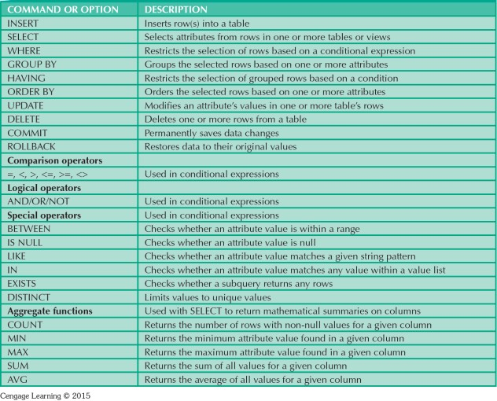
Table 7.2 - SQL Data Manipulation Commands

Slide 48
SQL statement structure
“Every SQL statement begins with a verb, a keyword or reserved word that declares what the statement does.”
“The statement continues with one or more clauses.”
“A clause may identify data or a database object to be operated on by the statement or it may provide more details about what the statement is going to do.”
“The clause also begins with a keyword, such as WHERE, FROM, INTO, and HAVING.”
“Some clauses are mandatory. Others are optional.”

Slide 49
SELECT
SELECT…FROM…statement
SELECT: Lists the columns that are to be returned in the results
FROM: Lists the tables or views from which data is to be selected
▪▪ List everything in a table
SELECT *
FROM table name;
▪▪ Limit columns to display
SELECT column1_name, column2_name FROM table_name;
▪▪ Sort results
SELECT column1_name, column2_name FROM table_name
ORDER BY column1_name ASC or DESC;

Slide 50
SELECT (Cont’d)
WHERE clause
Provides conditions for the selection of rows in the results
SELECT column1_name, column2_name FROM table_name
WHERE column3_name = 32306 ORDER BY column1_name;

Slide 51
Data Manipulation Language (DML) INSERT INTO
INSERT INTO
Insert new records in a table
Syntax
Implicit INSERT
(*Not stating what columns we want the values to be inserted into)
INSERT INTO tablename VALUES (first_value,...last_value);
Explicit INSERT
(*Instruct SQL which fields you want to insert data into)
INSERT INTO tablename (column_A, column_B, column_C) VALUES (first_value, second_value, third_value);
Examples
INSERT INTO employee (first, last, age, address, city, state)
VALUES ('Luke', 'Duke', 45, '2130 Boars Nest', 'Hazard Co', 'Georgia');
Notes:
Note that it begins with the keywords INSERT INTO followed by the name of the table in which we want to add this new row of data. And then we have an open parenthesis
and a comma separated list of attribute names followed by a close parenthesis.
Note: If we want to add non-numeric data such as text into one of the columns in the table, we must enclose that value in single quotes.

Slide 52
UPDATE
UPDATE
Update or change records that match a specified criteria
Syntax
UPDATE table_name
SET column1_name = “newvalue”
WHERE column2_name = “existingvalue”;
Examples
(A) UPDATE phone_book
SET area_code = 850
WHERE prefix = 979;
(B) UPDATE phone_book
SET area_code = 850;
what is the difference between A and B?
Notes:
UPDATE allows us to alter or modify the values of an existing row or set of rows within a table.
In this example, we're telling the database that I want to change a value in the phone_book table.
I want to change the area core to 850. And I want to make that change only for the row in the table which has prefix equal to 979.
It would set the are_code to 850 for every phone_book.

Slide 53
DELETE
DELETE
Delete records from the table
Syntax
DELETE FROM table_name WHERE columnname = “value”;
Examples
DELETE FROM employee WHERE lastname = 'May';

Slide 54
Data Definition Language (DDL) DROP TABLE/DATABASE
DROP TABLE
To delete a table
Syntax
DROP TABLE table_name
DROP DATABASE
To delete a database
Syntax
DROP DATABASE database_name

Slide 55
CREATE DATABASE
CREATE DATABASE
To create a database
Syntax
CREATE DATABASE dbname;

Slide 56
Aliases
Used to temporarily rename a table or a column
Syntax
SELECT column_name AS alias_name
FROM table_name;
Examples
SELECT CustomerName AS Customer FROM Customers;

Slide 57
SQL commands
SELECT: http://www.w3schools.com/sql/sql_select.asp
INSERT INTO: http://www.w3schools.com/sql/sql_insert.asp
UPDATE: http://www.w3schools.com/sql/sql_update.asp
DELETE: http://www.w3schools.com/sql/sql_delete.asp
ORDER BY: http://www.w3schools.com/sql/sql_orderby.asp
WHERE: http://www.w3schools.com/sql/sql_where.asp
AS (Aliases): http://www.w3schools.com/sql/sql_alias.asp

